Slide 1
Universities, Public-Private Partnerships, and the Innovation Ecosystem Opportunities Of Techno-industrial Innovation In Different Socio-cultural and Policy Situations: Diversities of Innovation School of Economics and Management, Tsing Hua University December, 13, 2015 Paul M.A. Baker, Ph.D. Senior Director of Research and Innovation Center for Advanced Communications Policy, Georgia Institute of Technology

Slide 2
INNOVATION, PARTNERSHIPS AND HIGHER EDUCATION
Importance of post-secondary learning in a global economy – new markets
Universities face a future of accelerating change and the need for rapid adaptability by institutional component – new research agendas
Shift from “education” to learning/training approaches that match employer needs to workforce skills – new partnership synergies
Innovation components:
Learning innovation (Higher Ed/ Advanced Skills /Technical Training)
Institutional innovation and change – the university as complex system(s)
Technologies of change (learning, collaboration, diffusion of innovation)
Networks of knowledge and collaboration
Policy as a tool for driving innovation

Slide 3
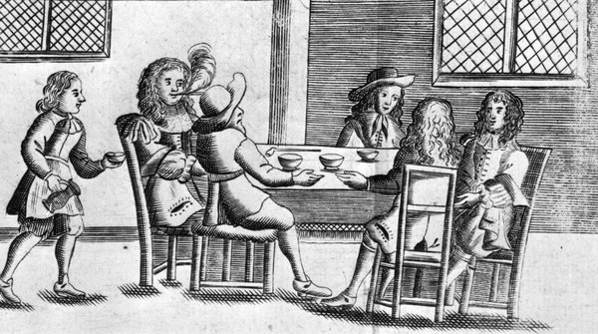
CHANGING CONTEXT OF HIGHER EDUCATION
Increased global competition for institutions, students, and employers
Technology driving new markets for learning/training opportunities
Changing demographics and different needs of learners
New processes/platforms: attention to economies, crowdsourcing, and collaboration
Impact of scale
Importance of locale in a virtual world
Interaction between teacher and student, student and material (e-accessibility), between researchers as well as between university researchers and industry
Branding and impact of value-added university services/capabilities

Slide 4
UNIVERSITIES, INNOVATION, AND REGIONAL CONTEXT
Storming of the ivory tower vs. lower the drawbridge
Rethinking ways in which universities engage the changing student, and the markets for students
Collaboration with industry to drive targeted (applied) research
Model of university as translational organization, value added to regional impact
University as virtual as well as physical locale
Develop virtual partnerships to mirror online educational efforts
Value added face to face to augment virtual
Workforce impact – shift from pure research to “training”

Slide 5
INSTITUTIONAL CHANGE ACTORS
Universities and other institutions of higher education
Public Sector (government)
Private sector, industry groups, platform developers
Associations, Accreditors, Foundations, NGOs
Users, consumers, students, employers
Ordering may be context sensitive

Slide 6
LEARNING, EDUCATION, AND CHANGE FACTORS
Online Information and the changing learner - skills + domain knowledge
Learning vs. education – student-focused vs. top-down programs
Assessment, Competencies, Skills
Certification/Validation of Learning
Collaborative Communities
Sustainability/access/ knowledge transfer digital technologies facilitate new instructional, engagement, participation, and learning approaches

Slide 7
INNOVATION LINKED PRACTICES AND PROCESSES
Shifts learner from“object” to “subject”—education not delivered, but learning facilitated in multiple contexts
Social Learning/impact of groups
Blended/Inverted learning approaches
Rethinking Accreditation/Direct Assessment
Alternative Certification
“Markets” for Learning Options
Learning and “knowledge upgrades”

Slide 8
INFORMATION DRIVEN TECHNOLOGIES
E-books, LMS (26+), Massively Open Online Courses (MOOCs) – more than 1,764 developed for the Coursera platform alone
MOOC platforms (25+) in addition to traditional Publishers
Collaborative learning communities/ impact of forums
Inverted Classrooms/Blended learning
Gamification/simulations
Data analytics

Slide 9
ECOLOGY OF PLATFORMS
Globally, 25+ MOOC platforms
Convergence between LMSs (26+) MOOCs, and traditional publishers
+/- 14 U.S.: Main MOOC platforms: Coursera, Udacity, edX, Udemy
International
AUS: Open2Study
Canada: WideWorldEd
Finland: Eliademy
Germany: Iversity
Spain: UniMOOC
The Netherlands: OpenUpEd
U.K.: Futurelearn, Open Learning
Brazil: Veduca

Slide 10
NEW METRICS OF ASSESSMENT
Real time analytics (in online environments)
Game and collaborative-based evaluation
Classroom “Clickers” (or equivalent in-person devices)
Peer evaluations
Crowdsourced reviews

Slide 11
“NEVER LET FORMAL EDUCATION GET IN THE WAY OF YOUR LEARNING.” ~ MARK TWAIN
CONTACT:
Paul M.A. Baker, Ph.D. paul@cacap.gatech.edu
Center for Advanced Communications Policy (CACP)
Georgia Institute of Technology
cacp.gatech.edu

