Slide 1
Improving Accessibility and Inclusion In STEM: Meeting the needs of Students with Disabilities
Dr. Nathan W. Moon Mr. Robert L. Todd Dr. Tristan T. Utschig
Center for Advanced Communications Center for Assistive Technology Center for the Enhancement of
Policy (CACP), and Environmental Access (CATEA), Teaching and Learning (CETL),
Georgia Institute of Technology Georgia Institute of Technology Georgia Institute of Technology
Atlanta, Georgia Atlanta, Georgia Atlanta, Georgia

Slide 2
Background: Disability Statistics
11% of Postsecondary Students Have a Disability
Disability Type | Distribution
Specific Learning Disabilities | 31%
ADD or ADHD | 18%
Mental Illness or Psychological/Psychiatric Condition | 15%
Health Impairment/(Chronic) Condition | 11%
Mobility Limitation/Orthopedic Impairment | 7%
Difficulty Hearing | 4%
Difficulty Seeing | 3%

Slide 3
Background: Disability Statistics (cont.)
Disability Type | Distribution
Cognitive Difficulties or Intellectual Disability | 3%
Autism Spectrum Disorders | 2%
Traumatic Brain Injury | 2%
Difficulty Speaking or Language Impairment | 1%
Other | 3%
SOURCES: U.S. Department of Education, National Center for Education Statistics. (2012). Digest of Education Statistics, 2011; Raue, K., and Lewis, L. (2011). Students With Disabilities at Degree-Granting Postsecondary Institutions (NCES 2011–018). U.S. Department of Education, National Center for Education Statistics. Washington, DC: U.S. Government Printing Office.

Slide 4
People with Disabilities and STEM
SOURCES: Population and U.S. workforce—U.S. Census Bureau, Survey of Income and Program Participation, 2005; Students 6-17—U.S. Department of Education, Office of Special Education Programs, 2008; Undergraduate and graduate students—U.S. Department of Education, National Center for Education Statistics, National Postsecondary Student Aid Study, 2008; STEM doctorate recipients, NSF/SRS, Survey of Earned Doctorates 2008, Workforce and doctoral faculty—National Science Foundation, SESTAT data system, and Survey of Doctorate Recipients, 2006.

Slide 5
Laws and Responsibilities
 | High School | Post-Secondary Institutions
Law | Individuals with Disabilities Act (IDEA) | Section 504 of Rehabilitation Act and Americans with Disabilities Act (ADA)
Responsibility | “Free and Appropriate Public Education” (FAPE) | Accessibility and Reasonable Accommodations
Implementation | Individualized Education Plans (IEP) | Student Responsibility to Reveal/Provide Documentation of Disability
Services | Individualized Instruction, Modifications, Accommodations | Reasonable Accommodations for Equal Access and Participation
Support | Program Support for Personnel | No Formal Program Support

Slide 6
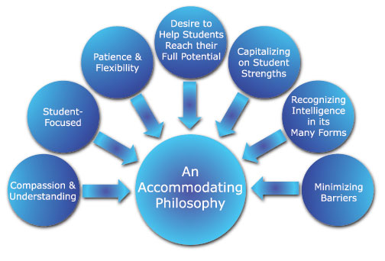
Instructor Attitudes toward Success

Slide 7
Typical Accommodations
Alternate Exam Formats or Additional Exam Time (88%)
Tutors to Assist with Ongoing Coursework (77%)
Readers, Classroom Notetakers, or Scribes (69%)
Registration Assistance or Priority Registration (62%)
Adaptive Equipment or Technology (58%)
Textbooks in Audio Format (55%)
Sign Language Interpreters (45%)
Course Substitutions or Waivers (42%)
SOURCE: National Center for Educational Statistics. [1999]. An institutional perspective on students with disabilities in postsecondary education. Washington DC: U.S. Department of Education.

Slide 8
Universal Design for Learning
Emphasis on Accessibility and Inclusion, Rather Than Individual Accommodation
“Design for All” Principles, Suitable for Postsecondary Teaching
Principles of Universal Design
Equitable Use
Flexibility in Use
Simple and Intuitive
Perceptible Information
Tolerance for Error
Low Physical Effort
Size and Space for Approach and Use

Slide 9
Universal Design for Learning: Examples
Class Climate: Syllabi Statements of Diversity/Inclusiveness
Interaction: Group Work Requiring Learners to Support Each Other with Value on Different Skills and Roles
Physical Environments and Products: Safety Procedures for All Students, Including Those Who Are Blind, Deaf, or Wheelchair Users
Delivery Methods: Multiple Modes to Deliver Content
Information Resources: Ensure Usability of Web Content
Feedback: Permit Feedback Opportunities for Large Projects
Assessment: Group Performance, In Addition to Individual Effort
Accommodation: Address Needs Not Met by UDL
SOURCE: Burghstahler, S. (2004). Universal Design for Instruction. http://www.washington.edu/doit/Faculty/Strategies/Universal/

Slide 10
Resources for Improving Accessibility
SciTrain: Science and Math for All
SciTrain University
BreakThru
GRADE: Georgia Tech Research on Accessible Distance Education
Accommodating Students with Disabilities in STEM
Other Resources

Slide 11
SciTrain: Science and Math for All
NSF-funded Project to Train Teachers about Accessible Science, Mathematics, and Computer Science Instruction
Intended for High School Teachers
Modules Available:
Universal design
Disability Laws
Vision
Hearing
Learning Disabilities
ADHD
Autism Spectrum Disorders
Mobility and Dexterity
Transitioning to University

Slide 12
SciTrain: Science and Math for All
Pedagogical Areas Addressed:
General Preparation
Lectures and Classroom Discussions
Classroom Setup
Group Work and Assignments
Tests and Exams
Computer Lab Set-up (Computer Science)
Hardware and Software (Computer Science
Additional Resources for Accommodations
Publications Database on Relevant Literature
More Information: http://www.catea.gatech.edu/scitrain

Slide 13
SciTrain University
U.S. Department of Education-sponsored Project to Improve Accessibility and Inclusion of Postsecondary STEM Instruction
Intended for College and University Faculty, Administrators
Modules Available
Accessible STEM Teaching 101
Improved Teaching for Large Lectures
Improving Online STEM Learning
Environments
Improving STEM Labs

Slide 14
SciTrain University
Universal Design Approach – Improving Instruction for All Students
Particular Emphasis on Learning Disabilities
Emphasis on Accessibility and Inclusion, Not Accommodations
Strategies for Classroom, Laboratory, and Fieldwork Instruction, as well as Group Assignments and Testing
More Information: http://www.catea.gatech.edu/scitrainu

Slide 15
BreakThru
NSF-sponsored Initiative of Georgia STEM Accessibility Alliance
Collaboration between Georgia Tech and University of Georgia, with Partners at Georgia Perimeter College and Clarke, Greene, and Gwinnett County High Schools
Online Learning Communities for Students with Disabilities
Second Life
Ning
Skype
Twitter
Online Discussion Groups

Slide 16
BreakThru
Community of Mentors and Students to Provide Support, Guidance, Opportunities for Social/Academic Development, and Resources
Mentors Include:
Secondary Science and Mathematics Teachers
Postsecondary STEM Faculty
STEM Graduate Students
Advanced BreakThru Participants
Project Staff
Focus on Transition from High School to College and Entry into STEM Workforce

Slide 17
BreakThru

Slide 18
BreakThru
More Information:
Website: http://www.georgiabreakthru.org
Blog: http://blog.georgiabreakthru.org
YouTube channel: http://www.youtube.com/user/BreakThruGSAA
Facebook page: http://www.facebook.com/BreakThruGSAA

Slide 19
GRADE: Georgia Tech Research on Accessible Distance Education
Legacy Project Funded by U.S. Department of Education
Intended for Postsecondary Online and Distance Education Programs
Modules to Address Accessibility in Distance Education:
PowerPoint
Video
Flash
Word documents
Excel spreadsheets
PDF documents
Webpages
Scripts and Java

Slide 20
GRADE: Georgia Tech Research on Accessible Distance Education
Course Design Models
Fact Sheets with Quick Tips, Solutions, and Summary of Issues
Guidelines and Legal issues for Accessible Distance Education
More information: http://www.catea.gatech.edu/grade/

Slide 21
Accommodating Students with Disabilities in STEM
NSF-sponsored Handbook for Educators, Service Providers, Administrators, and Policymakers
Synthesis of the Research and Practitioner Literatures on Accommodations and Accessibility in STEM
Middle Grades to University Education Audiences
Organized by Disability/Functional Ability Category and STEM Discipline
FREE Copy: http://www.catea.gatech.edu/scitrain/accommodating.pdf

Slide 22
Other Resources
Alternative Media Access Center (AMAC)
Electronic Textbooks and Accessible E-text, Braille, Captioning, and Audio Services
Georgia Board of Regents (BoR) Membership, with Discounts and Services for USG institutions
http://www.amacusg.org/
DO-IT Center at University of Washington
AccessSTEM Resources
Knowledge Base of Articles, Case Studies, and Promising Practices to Improve Accessibility of STEM
http://www.washington.edu/doit/
Observation Instruments from SciTrain U

Slide 23
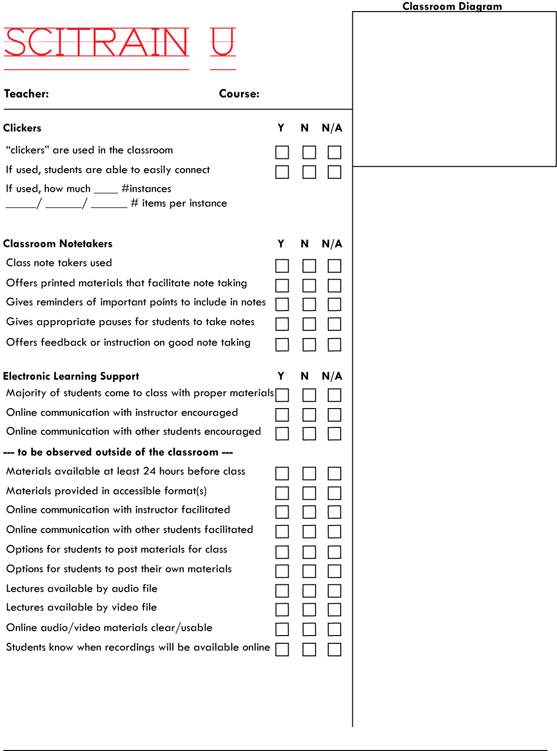
SciTrain U Classroom Observation Instrument

Slide 24
Conclusion
“The long-term prosperity of our Nation will increasingly rely on talented and motivated individuals who will comprise the vanguard of scientific and technological innovation.”
“Every student in America deserves the opportunity to achieve his or her full potential.”
- National Science Board, Preparing the Next Generation of STEM Innovators, 2010

Slide 25
Acknowledgements
The authors express their appreciation to Chris Langston, David Morton, Summer Ienuso, and Stephen Rehberg for their contributions to this presentation. We also recognize our BreakThru partners at the University of Georgia, including Noel Gregg and Gerri Wolfe.
SciTrain is supported by the National Science Foundation under Grant No. 0622885. SciTrain U is supported by the U.S. Department of Education, Office of Post-Secondary Education, Grant No. P333A080022. BreakThru is supported by the National Science Foundation, Research in Disabilities Education, under Grant No. 1027655. GRADE is supported by the U.S. Department of Education, Office of Post-Secondary Education, under Grant No. P333A020050.
Any opinions, findings, and conclusions or recommendations expressed in this material are those of the author(s) and do not necessarily reflect the views of the National Science Foundation or the U.S. Department of Education.

