Slide 1
Improving Accessibility and Inclusion In STEM Graduate Education
Susan Cozzens, PhD Nathan W. Moon, PhD
Vice Provost, Graduate Education and Research Scientist, Center for
Faculty Affairs Advanced Communications Policy
Georgia Institute of Technology Georgia Institute of Technology
Atlanta, Georgia Atlanta, Georgia

Slide 2
Broadening Participation in STEM
“The nation's economic prosperity, security, and quality of life depends on the identification and development of our next generation of STEM innovators.”
“Every student in America should be given the opportunity to reach his or her full potential.”
- National Science Board, 2010
Notes:
In short, equity and excellence go hand in hand. Message of the National Science Foundation, which has sought to broaden participation in STEM through various programs and efforts.

Slide 3
Disability Statistics
11% of Postsecondary Students Have a Disability
Disability Type | Distribution
Specific Learning Disabilities | 31%
ADD or ADHD | 18%
Mental Illness or Psychological/Psychiatric Condition | 15%
Health Impairment/(Chronic) Condition | 11%
Mobility Limitation/Orthopedic Impairment | 7%
Difficulty Hearing | 4%
Difficulty Seeing | 3%

Slide 4
Disability Statistics (continued)
Disability Type | Distribution
Cognitive Difficulties or Intellectual Disability | 3%
Autism Spectrum Disorders | 2%
Traumatic Brain Injury | 2%
Difficulty Speaking or Language Impairment | 1%
Other | 3%
SOURCES: U.S. Department of Education, National Center for Education Statistics. (2012). Digest of Education Statistics, 2011; Raue, K., and Lewis, L. (2011). Students With Disabilities at Degree-Granting Postsecondary Institutions (NCES 2011–018). U.S. Department of Education, National Center for Education Statistics. Washington, DC: U.S. Government Printing Office.

Slide 5
Opportunities and Barriers in STEM
Opportunities in STEM continue to grow…
STEM jobs projected to increase by 17% between 2008-2018, vs. 10% for non-STEM jobs.
U.S. to need 1 million more graduates in STEM than currently produced.
…But barriers persist for Americans with disabilities:
19% of the U.S. population, but less than 10% of its employed scientists and engineers.
Students with disabilities represent only 10% of undergraduate, 7% of graduate, and 1% of doctoral-level STEM majors.
Challenge of persistence in STEM; Issues of inaccessible pedagogy and negative attitudes.

Slide 6
Research and Demonstration Projects at Georgia Tech
Student-Oriented: Improving Persistence in
STEM Through E-Mentoring
Faculty-Oriented: Supporting Accessibility and
Inclusion in STEM Instruction

Slide 7
BreakThru: Georgia STEM Accessibility Alliance (GSAA)

Slide 8
http://www.georgiabreakthru.org

Slide 9
NSF’s Research in Disabilities Education (RDE) Alliances Program

Slide 10
Goals of GSAA and BreakThru
Increase the number of secondary students with disabilities enrolling in STEM postsecondary classes and majors.
Increase the retention and graduation of postsecondary students with disabilities in STEM majors.
Increase the successful entry of postsecondary students with disabilities into STEM graduate programs or the STEM workforce.

Slide 11
Virtual Worlds and Social Media

Slide 12
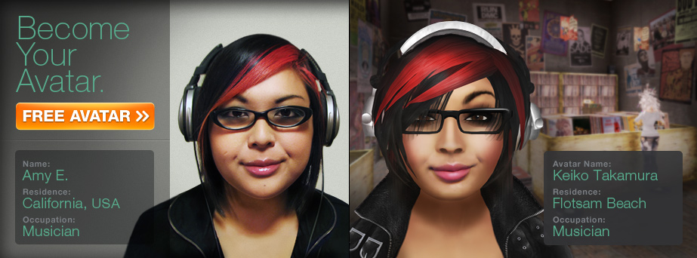
Why Virtual Worlds?
BreakThru has been created to provide broad impact through:
Applicability to students and faculty who are separated geographically,
Gathering a national/international network of STEM stakeholders
Creating immersive environments for students who may have difficulty with face-to-face interactions (autism, LD, and ADHD)
Offering control over identity and representation for students with disabilities

Slide 13
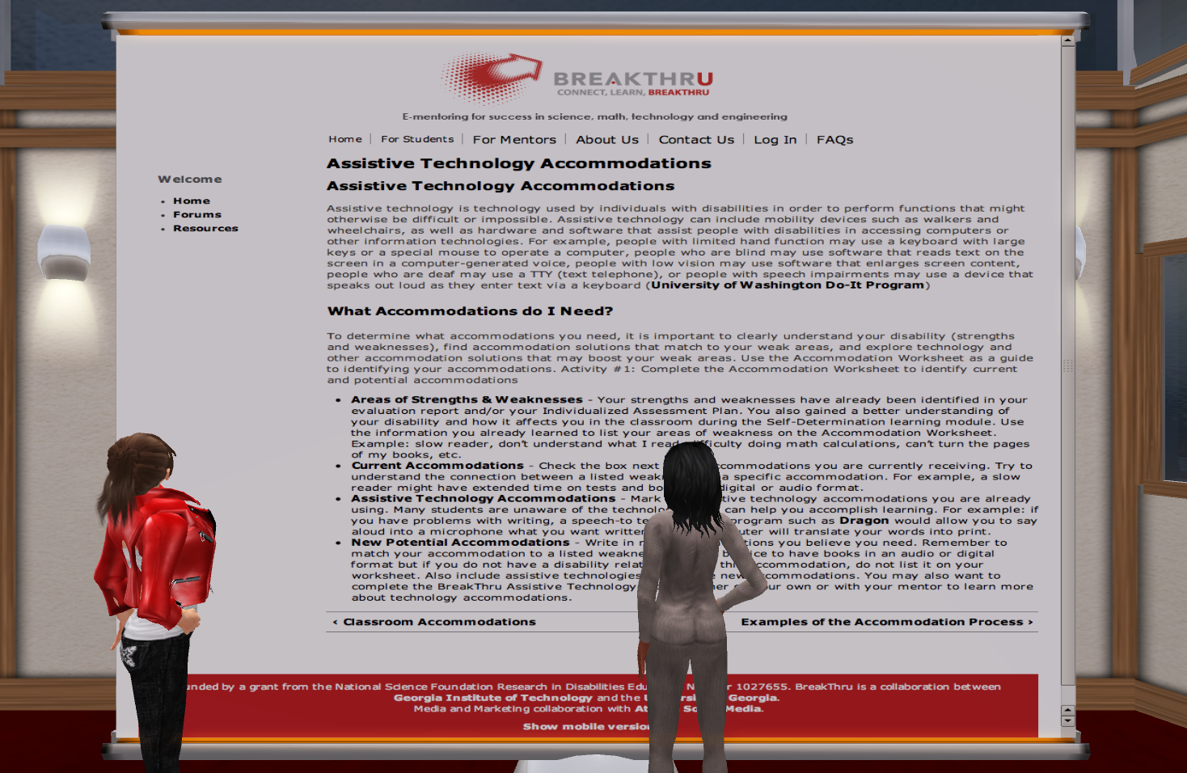
Electronic Mentoring
25 Learning Modules
4 Critical Modules: Introduction to STEM, Self-Determination, Classroom Accommodations, Time Management
Other Key Modules: Math/Science/Test Anxiety, Forming Study Groups, Taking Notes, STEM Study Skills
E-Mentoring Sessions
Meetings at Least Monthly
Surveys of Mentors/Mentees
Emphasis on Student
Support for Persistence

Slide 14
SciTrain University (SciTrainU)
Demonstration Project funded by U.S. Department of Education
Intended for College and University Faculty, Administrators
Emphasis on Universal Design for
Learning (UDL) – Design For All

Slide 15
http://www.catea.gatech.edu/scitrainU

Slide 16
SciTrainU Overview
Four Modules Available
Accessible STEM Teaching 101
Improved Teaching for Large Lectures
Improving Online STEM Learning
Environments
Improving STEM Labs
Particular Emphasis on Learning Disabilities
Emphasis on Accessibility and Inclusion, Not Accommodations
Strategies for Classroom, Laboratory, and Fieldwork Instruction, as well as Group Assignments and Testing

Slide 17
Thinking About Accessibility And Inclusion in STEM Education
Accommodations Approaches and Universal Design for Learning (UDL) Approaches in STEM Education

Slide 18
Laws and Responsibilities

Slide 19
Common Accommodations in STEM
Alternate Exam Formats or Additional Exam Time (88%)
Tutors to Assist with Ongoing Coursework (77%)
Readers, Classroom Notetakers, or Scribes (69%)
Registration Assistance or Priority Registration (62%)
Adaptive Equipment or Technology (58%)
Textbooks in Audio Format (55%)
Sign Language Interpreters (45%)
Course Substitutions or Waivers (42%)
SOURCE: National Center for Educational Statistics. [1999]. An institutional perspective on students with disabilities in postsecondary education. Washington DC: U.S. Department of Education.

Slide 20
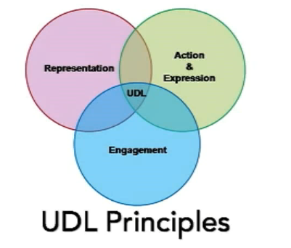
Beyond Accommodations: Universal Design for Learning
Developing instruction and pedagogy that work for everyone, not a single “one size fits all” approach to learning.
Successful and well-designed adaptations may make coursework and labs more approachable and effective for all students, not only those with disabilities.
3 key principles:
Multiple Means of Representation
Multiple Means of Expression
Multiple Means of Engagement

Slide 21
Common UDL Approaches in STEM
Class Climate: Syllabi Statements of Diversity/Inclusiveness
Interaction: Group Work Requiring Learners to Support Each Other with Value on Different Skills and Roles
Physical Environments and Products: Safety Procedures for All Students, Including Those Who Are Blind, Deaf, or Wheelchair Users
Delivery Methods: Multiple Modes to Deliver Content
Information Resources: Ensure Usability of Web Content
Feedback: Permit Feedback Opportunities for Large Projects
Assessment: Group Performance, In Addition to Individual Effort
Accommodation: Address Needs Not Met by UDL
SOURCE: Burghstahler, S. (2004). Universal Design for Instruction. http://www.washington.edu/doit/Faculty/Strategies/Universal/

Slide 22
Considerations for Graduate Education
Importance of Faculty Attitudes
Mentorship and advisement play a greater role in graduate education; keys to persistence and completion of graduate education
Accessibility of Laboratories and Fieldwork
Need to consider creative solutions to accessibility challenges; not always a high-tech solution
Furnishings, manipulation, and visualization of materials/supplies present barriers that are solvable
Process barriers: There are presently no supports in place to make customized equipment accessible – need to consider accessibility and usability at outset

Slide 23
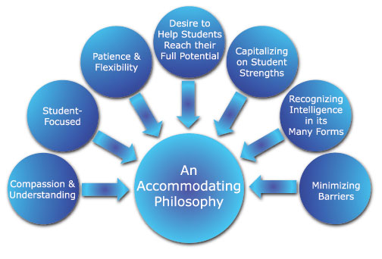
Faculty Attitudes toward Success

Slide 24
Resources at Georgia Tech
http://www.georgiabreakthru.org/
http://www.catea.gatech.edu/scitrainU/
http://www.catea.gatech.edu/scitrain/
(for secondary education)

Slide 25
Resources at Georgia Tech
http://www.amacusg.org/
Accessible instructional materials for postsecondary education
http://www.catea.gatech.edu/scitrain/accommodating.pdf
Free e-book on classroom and lab accommodations in STEM

Slide 26
Additional Resources
Introduction to Universal Design
Theory of UDL
Implementing Multiple Means of Representation/Expression/Engagement
http://www.udlcenter.org/
Theory of UDI
Implementing the Seven Principles of Universal Design in Instruction
http://www.washington.edu/doit/Brochures/Academics/instruction.html

Slide 27
Thank You!
For questions or a copy of this presentation, please e-mail: nathan.moon@cacp.gatech.edu
We acknowledge our colleagues Robert L. Todd (PI), Christopher Langston (Co-PI), Maureen Linden (Co-PI) at Georgia Tech and Noel Gregg (PI) and Gerri Wolfe (GSAA Mentorship Lead) at the University of Georgia.
Funded by a grant from the National Science Foundation (NSF), Research in Disabilities Education (RDE), Grant Nos. 1027635 and 1027655. GSAA/BreakThru is a collaboration between the Georgia Institute of Technology and the University of Georgia.

