Slide 1
Virtual worlds for supporting stem education and workforce development
Nathan W. Moon, PhD
Research Scientist
Center for Advanced Communications Policy
Georgia Institute of Technology
Atlanta, Georgia

Slide 2
Broadening Participation in STEM
“The nation's economic prosperity, security, and quality of life depends on the identification and development of our next generation of STEM innovators.”
“Every student in America should be given the opportunity to reach his or her full potential.”
- National Science Board, 2010
Notes:
In short, equity and excellence go hand in hand. Message of the National Science Foundation, which has sought to broaden participation in STEM through various programs and efforts.

Slide 3
Disability Statistics
11% of Postsecondary Students Have a Disability
Disability Type | Distribution
Specific Learning Disabilities | 31%
ADD or ADHD | 18%
Mental Illness or Psychological/Psychiatric Condition | 15%
Health Impairment/(Chronic) Condition | 11%
Mobility Limitation/Orthopedic Impairment | 7%
Difficulty Hearing | 4%
Difficulty Seeing | 3%

Slide 4
Disability Statistics (continued)
Disability Type | Distribution
Cognitive Difficulties or Intellectual Disability | 3%
Autism Spectrum Disorders | 2%
Traumatic Brain Injury | 2%
Difficulty Speaking or Language Impairment | 1%
Other | 3%
SOURCES: U.S. Department of Education, National Center for Education Statistics. (2012). Digest of Education Statistics, 2011; Raue, K., and Lewis, L. (2011). Students With Disabilities at Degree-Granting Postsecondary Institutions (NCES 2011–018). U.S. Department of Education, National Center for Education Statistics. Washington, DC: U.S. Government Printing Office.

Slide 5
Opportunities and Barriers in STEM
Opportunities in STEM continue to grow…
STEM jobs projected to increase by 17% between 2008-2018, vs. 10% for non-STEM jobs.
U.S. to need 1 million more graduates in STEM than currently produced.
…But barriers persist for Americans with disabilities:
19% of the U.S. population, but less than 10% of its employed scientists and engineers.
Students with disabilities represent only 10% of undergraduate, 7% of graduate, and 1% of doctoral-level STEM majors.
Challenge of persistence in STEM; Issues of inaccessible pedagogy and negative attitudes.

Slide 6
Research and Demonstration Projects at Georgia Tech
Student-Oriented: Improving Persistence in
STEM Through E-Mentoring
Faculty-Oriented: Supporting Accessibility and
Inclusion in STEM Instruction

Slide 7
BreakThru: Georgia STEM Accessibility Alliance (GSAA)

Slide 8
http://www.georgiabreakthru.org

Slide 9
NSF’s Research in Disabilities Education (RDE) Alliances Program

Slide 10
Goals of GSAA and BreakThru
Increase the number of secondary students with disabilities enrolling in STEM postsecondary classes and majors.
Increase the retention and graduation of postsecondary students with disabilities in STEM majors.
Increase the successful entry of postsecondary students with disabilities into STEM graduate programs or the STEM workforce.

Slide 11
Virtual Worlds and Social Media

Slide 12
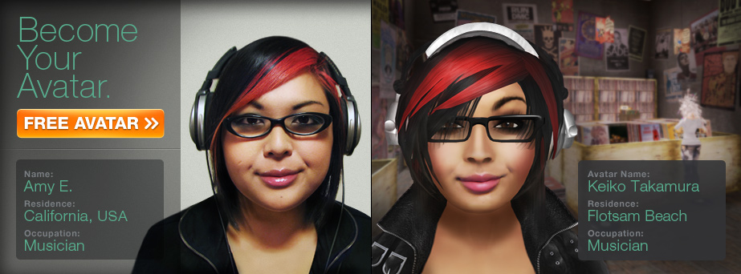
Why Virtual Worlds?
BreakThru has been created to provide broad impact through:
Applicability to students and faculty who are separated geographically,
Gathering a national/international network of STEM stakeholders
Creating immersive environments for students who may have difficulty with face-to-face interactions (autism, LD, and ADHD)
Offering control over identity and representation for students with disabilities
Notes:
Because of geographic distances or the lack of integration into formal disability-focused communities, many SwD do not have the opportunities to meet and form relationships with peers that share the same health or social experiences.

Slide 13
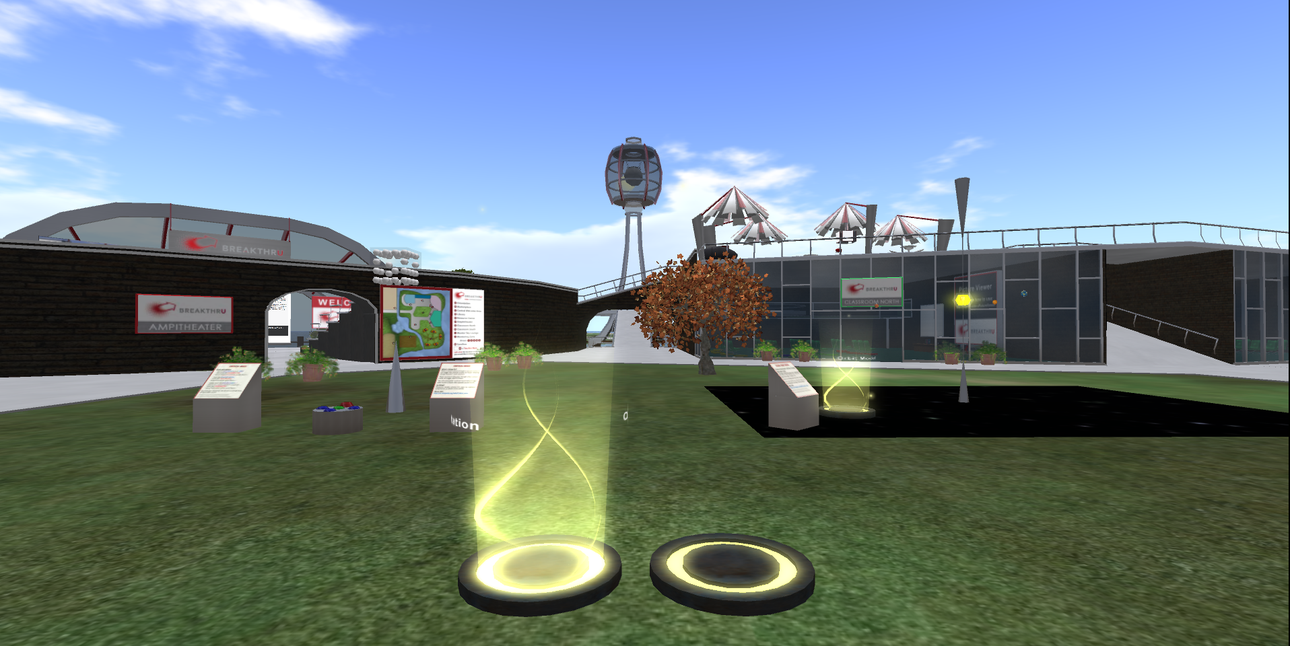
BreakThru Island
Notes:
2013 increased interactivity. Fishing, exploration, collection, challenge games.

Slide 14
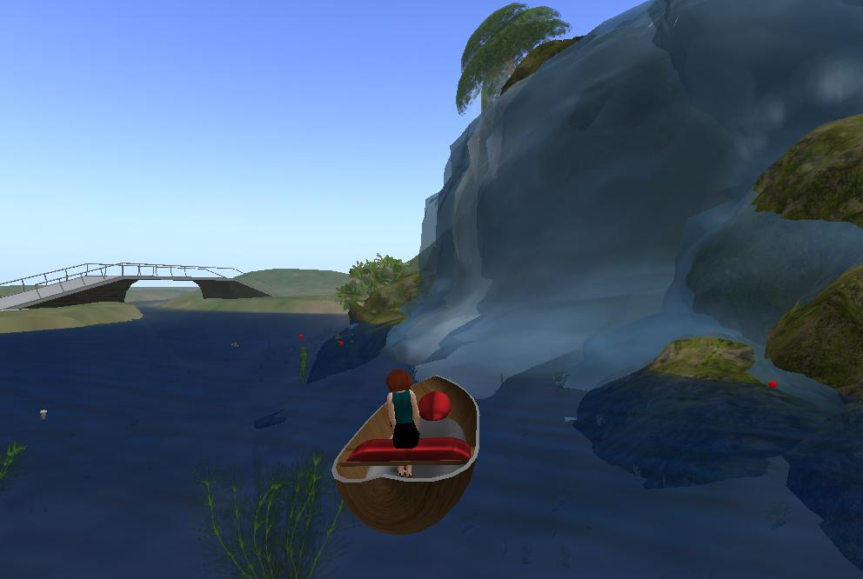
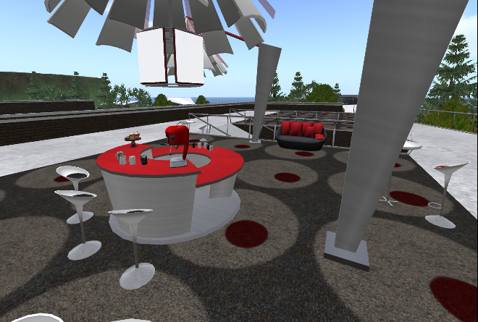
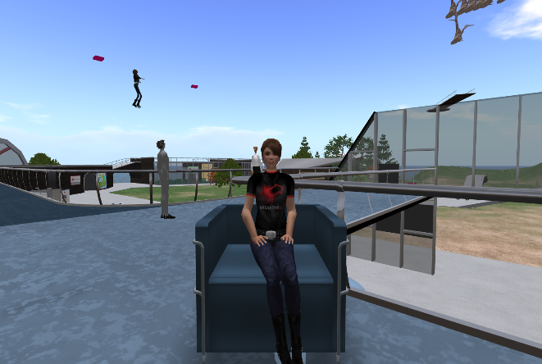
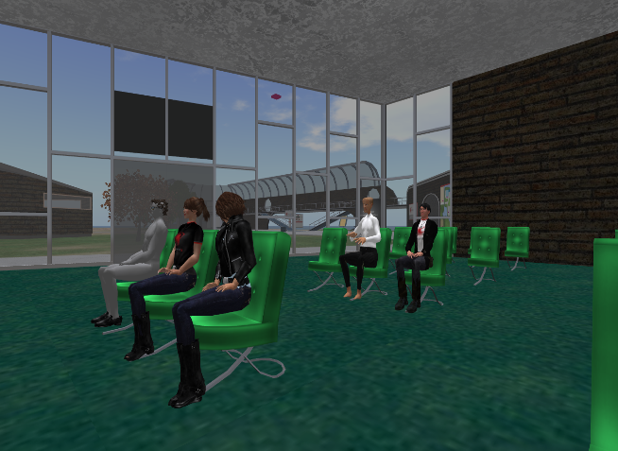
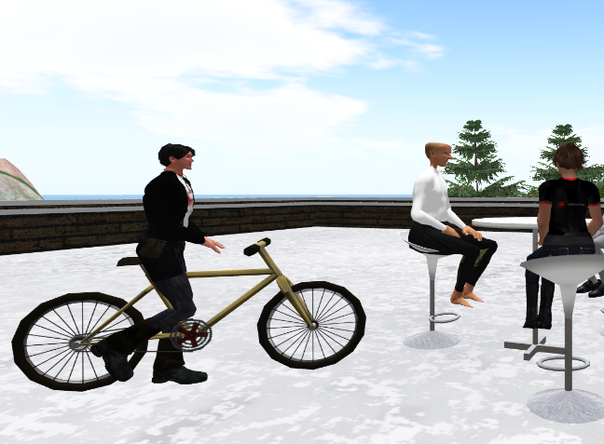
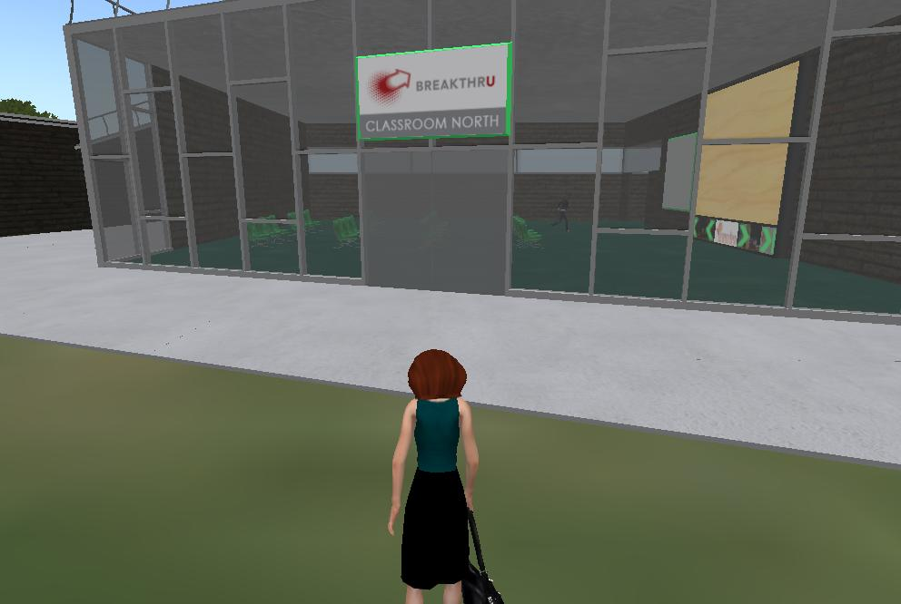
Additional Features of BreakThru
Notes:
Interactivity and interconnectedness are the highlights here. Activities (experiments, games, fishing, etc.) and blending of island populations for special events.

Slide 15
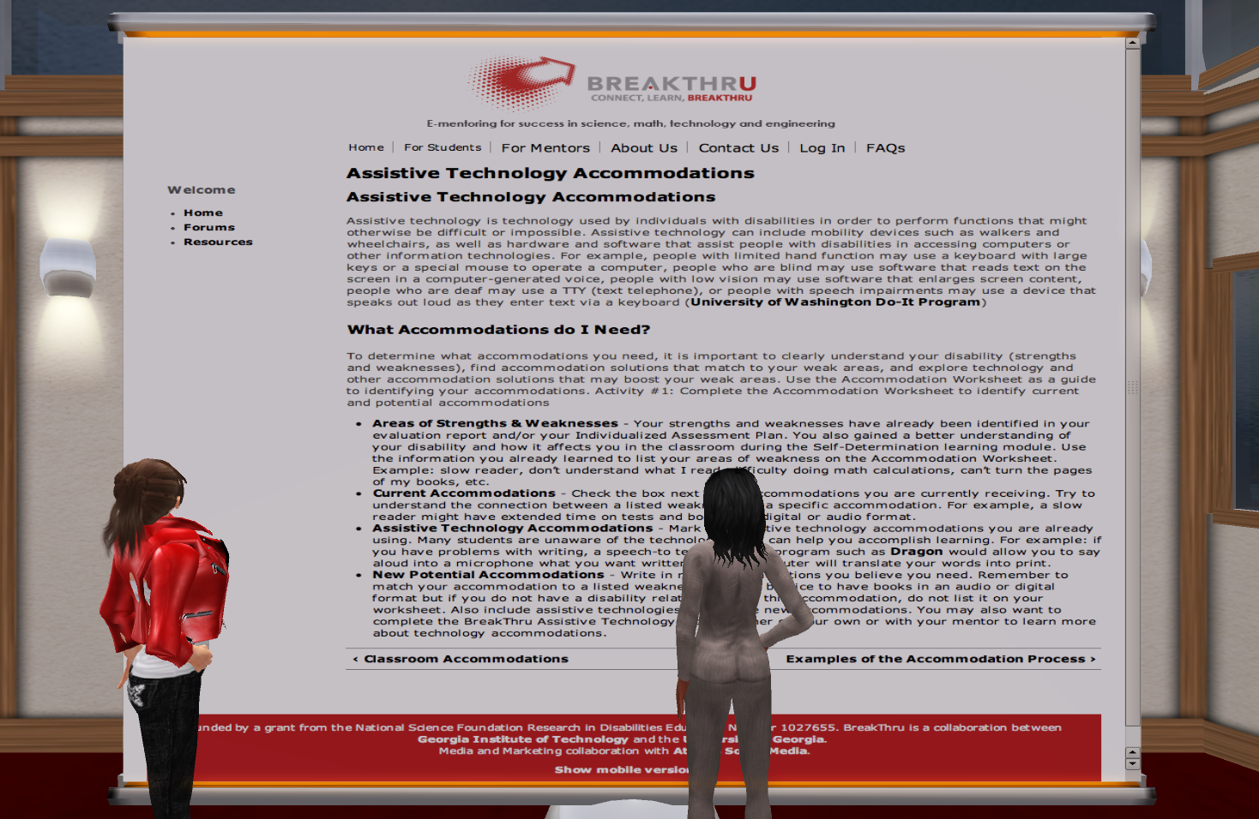
Electronic Mentoring
25 Learning Modules
4 Critical Modules: Introduction to STEM, Self-Determination, Classroom Accommodations, Time Management
Other Key Modules: Math/Science/Test Anxiety, Forming Study Groups, Taking Notes, STEM Study Skills
E-Mentoring Sessions
Meetings at Least Monthly
Surveys of Mentors/Mentees
Emphasis on Student
Support for Persistence

Slide 16
Continuing vs. New Students

Slide 17
Theory of Change

Slide 18
Communication Methods
Communications Methods Utilized Across 5 Reporting Periods
Survey Responses | Text |  |  | Voice |  |  | In Person
 | Email | Facebook | SMS | Second Life | Skype | Phone
Secondary Mentees Total (=36) | 81% | 8% | 75% | 47% | 11% | 69% | 61%
Post-Secondary Mentees Total (n=61) | 97% | 31% | 57% | 52% | 20% | 69% | 15%
Secondary Mentors Total (n=43) | 84% | 5% | 67% | 44% | 16% | 70% | 44%
Post-Secondary Mentors Total (n=61) | 97% | 31% | 57% | 32% | 20% | 69% | 15%
Notes:
Participants generally reported a higher frequency of usage with communication platforms with which they were already acquainted. Email and phone, unsurprisingly, were reported as the most commonly used communication methods. Interestingly, SMS was reported as a more frequent method of communication than traditional telephone among secondary mentees. Regarding Second Life specifically, adoption was slightly higher among post-secondary mentors and mentees.

Slide 19
Changes in Internal Characteristics Postsecondary – 2011-2015

Slide 20
Accessibility and Usability of Virtual Worlds
Lessons Learned from BreakThru’s Use of Second Life

Slide 21
General Challenges
Conceptual Challenges
Need to Explain Benefits of Second Life to New Users
“Culture” of Virtual Worlds: Group Communication, Removal of Geographic Boundaries
Technical Challenges
Computer (processor, memory, graphics) and Internet speed requirements
Security requirements and school/employer policy implications
Microphone requirements
Need for ongoing tech support
Lack of mobile platforms and weak iPhone, iPad clients

Slide 22
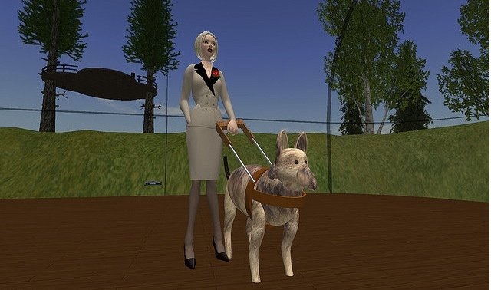
Sensory Disabilities: Blindness and Low Vision
Second Life is an image-intensive environment
Second Life browser generally incompatible with screen readers
Lack of metadata in the world to label objects
Undefined objects and features means a lack of control and perceptibility

Slide 23
Accessibility for Blind Users
Alternate browsers, paired with voice-output screen readers
TextSL with JAWS
Metabolt with JAWS
Radegast with speech plugin or NVDA (non-visual desktop access) reader
Virtual Guidedog with Max Voice Plus
IBM AbilityLab Virtual Worlds Accessible User Interface
Problem of Dwindling Support
Notes:
Latif Khalifa, forced to end support for Radegast in 2014

Slide 24
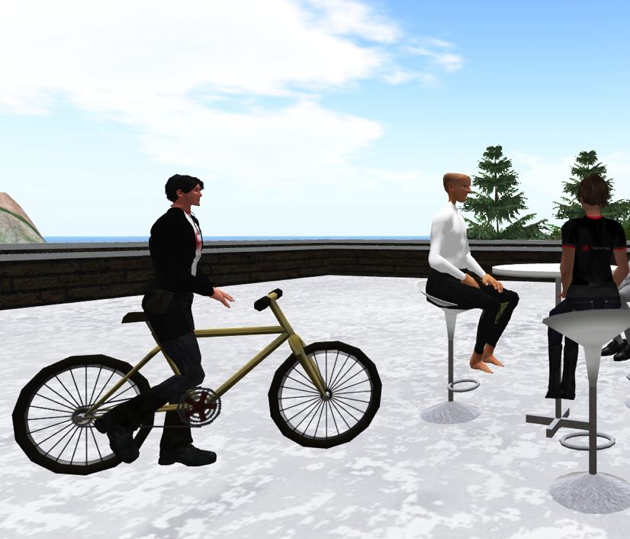
Metadata as Alt Text in Second Life
Provision of Metadata for each object in-world
For example “bicycle,” “chair,” “round cafe table”

Slide 25
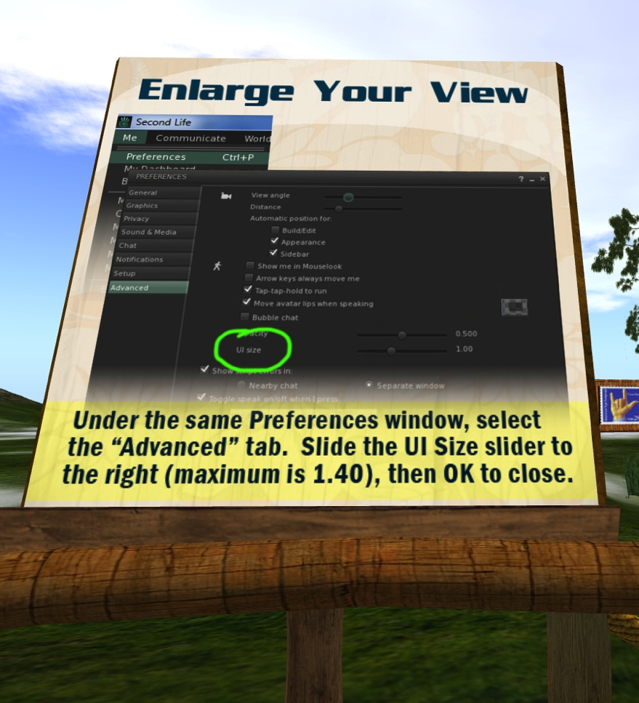
Accessibility for Low Vision Users

Slide 26
Second Life Text Options

Slide 27
Second Life UI Options

Slide 28
Deaf and Hard of Hearing
In general, Second Life has been relatively useful to students with deafness/hard of hearing because of frequent use of text chat
Microphones add potential problems
No access to voice-only interactions
Need to self-identify as deaf
Second Life built-in voice recording can be problem for events

Slide 29
Deaf and Hard of Hearing
Those who use sign language as a first language may face barriers to access similar to those with difficulty reading caused by slower written language skills.
In effect, these individuals are forced to use a “second language” to communicate since American Sign Language is not supported by Second Life.
These users often report a “lag” in textual communication, but few claim it is an insurmountable barrier.

Slide 30
Second Life usage study
Findings from a Qualitative Study of Second Life Usage in BreakThru

Slide 31
Second Life Study
Interview-Based Qualitative Study with Content Analysis (Miles, 1994)
Participant Classification (N=16) into Four Categories
SL + Used SL twice during last two semesters
SL - Used SL at least once; discontinued use
SL +/- Trained in SL; never used it for mentoring
SL -/- Never trained in SL and never used SL

Slide 32
Decision Tree for Protocols

Slide 33
SL + Participants: Key Findings
Tech-savvy mentors encourage mentees to use Second Life
Most participants use Second Life for at least one hour per week
Texting is the most commonly used Second Life technology
Participants communicate about disability-related issues and modules
Second Life might be particularly useful for participants with ADHD
Some believe Second Life is only for gamers or individuals with social anxiety
Obtaining reliable and current hardware is an obstacle to using Second Life
Incorporating an app version will increase usage

Slide 34
SL-/- Participants: Key Findings
Currently, visually‐impaired participants cannot use Second Life
Provide a compatible screen reader and incorporate an app to increase usage
Some associate a negative stigma of Second Life from a Law & Order: SVU episode
Computer and Internet access at work and home are barriers for secondary participants
Mentors and mentees rarely have overlapping availability
Second Life is not integrated into daily life and is therefore not easy to use

Slide 35
Overarching Lessons
Second Life is not intuitive; training is essential
Synchronous nature of Second Life may work against its use
Second Life requires processing power and fast Internet speed; out-of-touch in increasingly mobile world
Accessibility issues, especially for JAWS (Job Access with Speech) users
Perception—both positive and negative—is determinant in use or disuse
For committed users, however, it can deliver a positive experience

Slide 36
Technology Considerations
Virtual worlds are a key focus, but must be supported by other tools.
89% of Americans age 18-29 use social media.
Students are best reached through tools they already know.
Second Life is the best fit for some mentoring activities, but not all.
Students are increasingly studying from locations where they do not have administrative rights to install the Second Life client.

Slide 37
Final Thoughts
Platforms evolve faster than research projects
Hardware requirements sometimes cause a barrier
Participants increasingly rely on mobile technology
Most readily available platform is typically chosen
Convenience and costs as drivers

Slide 38
Resources at Georgia Tech
http://www.georgiabreakthru.org/
http://www.catea.gatech.edu/scitrainU/
http://www.catea.gatech.edu/scitrain/
(for secondary education)

Slide 39
Thank You!
For questions or a copy of this presentation, please e-mail: nathan.moon@cacp.gatech.edu
We acknowledge our colleagues Robert L. Todd (PI), Christopher Langston (Co-PI), Maureen Linden (Co-PI) at Georgia Tech and Noel Gregg (PI) and Gerri Wolfe (GSAA Mentorship Lead) at the University of Georgia.
Funded by a grant from the National Science Foundation (NSF), Research in Disabilities Education (RDE), Grant Nos. 1027635 and 1027655. GSAA/BreakThru is a collaboration between the Georgia Institute of Technology and the University of Georgia.

