Slide 1
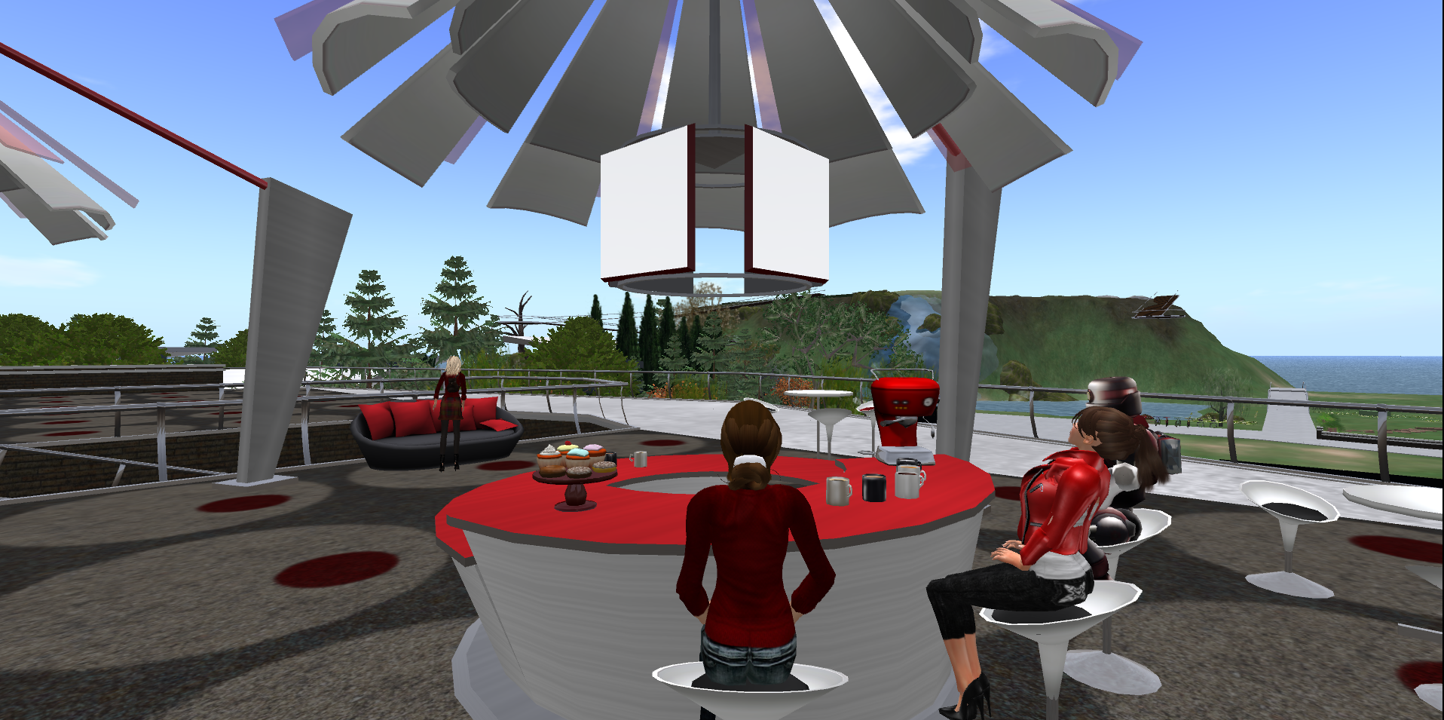
Connect, Learn, BreakThru: Summative Findings from Five Years of Electronic Mentoring in STEM Education

Slide 2
Georgia STEM Accessibility Alliance (GSAA)
Funded by a grant from the National Science Foundation (NSF), Research in Disabilities Education (RDE), Grant Nos. 1027635 and 1027655. BreakThru is a collaboration between the Georgia Institute of Technology and the University of Georgia.
Notes:
GT, GPC, UGA, Clarke, Greene, Gwinnett

Slide 3
GSAA Collaborative Leaders
University of Georgia
Noel Gregg (ngregg@uga.edu)
Gerri Wolfe (gwolfe@uga.edu)
Georgia Institute of Technology
Robert L. Todd (robert.todd@coa.gatech.edu)
Chris L. Langston (chris.Langston@coa.gatech.edu)
Nathan W. Moon (nathan.moon@cacp.gatech.edu)

Slide 4
What is BreakThru?
Online learning and mentoring community
Connects students and mentors virtually
Promotes accessibility and achievement in Science, Technology, Engineering, and Math (STEM) courses

Slide 5
Project Goals
The project serves as a pipeline between secondary and postsecondary institutions to strengthen students with disabilities’ capacities to access and succeed in STEM programs across critical junctures: high school > two-year college > four-year college > graduate school.
The overall project goals are to increase the retention of students with disabilities who are enrolled in STEM classes and majors and the number of students participating in BreakThru mentoring activities.

Slide 6
NSF Project Goals
Retain Students in Virtual Mentoring and STEM Majors:
Year-to-year persistence rate of at least 50%.
Enroll to Virtual Mentoring:
105 unduplicated high school students with disabilities by end of project period.
65 unduplicated two-year students with disabilities by end of project period.
55 unduplicated four-year students with disabilities by end of the project period.

Slide 7
Continuing vs. New Students

Slide 8
Theory of Change – In Brief

Slide 9
E-Mentoring Constructs -Spring 2015
Constructs | Mean | Rank
Communication-quality | 4.24 | 1
Personal Responsibility | 4.10 | 2
Satisfaction | 4.09 | 3
Support-seeking | 4.07 | 4
Communication-quantity | 3.85 | 5

Slide 10
Changes in Internal Characteristics Postsecondary - Overall

Slide 11
Changes in Internal Characteristics Secondary – Overall

Slide 12
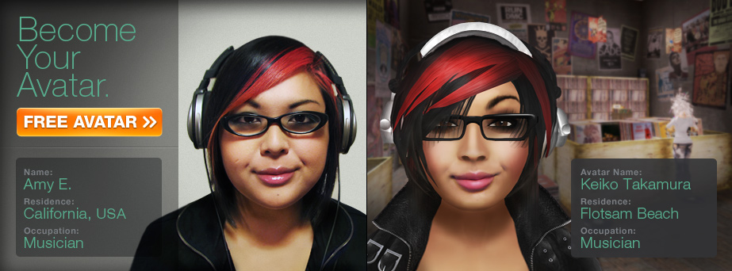
In Brief: Benefits of Virtual Worlds
Mediated consequences
Individualization
Creative Solutions
Immersion
Collaborative Learning
Control over Personal Representation
Access to Mentors

Slide 13
The Good, the Bad – the Avatars
Avatars in virtual worlds and other forms of online engagement can offer important affordances:
Immersion
Active engagement
Creating
Making real-world disabilities - disappear

Slide 14
The Good, the Bad – the Avatars
But virtual avatars and other online tools can create significant barriers:
Complexity of access and use
Student and teacher reluctance to accept as educational tools
Information technology issues
Privacy, security, distraction

Slide 15
Effectiveness of Virtual Worlds and Communications Platforms
Selection of Communications Platform
Text (E-mail, Facebook, SMS)
Voice (Second Life, Skype, Telephone)
In-person
2. Usage Characteristics for Second Life
Frequency and Concurrency
Use of Badging and Features

Slide 16
Communication Methods
Table 1. Communications Methods Utilized Across 5 Reporting Periods
Survey Responses | Text |  |  | Voice |  |  | In Person
 | Email | Facebook | SMS | Second Life | Skype | Phone
Secondary Mentees Total (=36) | 81% | 8% | 75% | 47% | 11% | 69% | 61%
Post-Secondary Mentees Total (n=61) | 97% | 31% | 57% | 52% | 20% | 69% | 15%
Secondary Mentors Total (n=43) | 84% | 5% | 67% | 44% | 16% | 70% | 44%
Post-Secondary Mentors Total (n=61) | 97% | 31% | 57% | 32% | 20% | 69% | 15%
Notes:
Participants generally reported a higher frequency of usage with communication platforms with which they were already acquainted. Email and phone, unsurprisingly, were reported as the most commonly used communication methods. Interestingly, SMS was reported as a more frequent method of communication than traditional telephone among secondary mentees. Regarding Second Life specifically, adoption was slightly higher among post-secondary mentors and mentees.

Slide 17
Total VLR Users Per Month
Fig. 1. Fall 2012 – Fall 2014 Total VLR Users per Month
Notes:
3 years of user data mapped onto months. What we see is a typical trend with high usage early in the semester during Fall when training are required, and then a drop off until the next semester. Months coinciding with large, organized events hosted by the project have much higher peaks.

Slide 18
Peak Concurrency
Fig. 2. Sep – Nov 2012 Peak Concurrency by Day
Notes:
Peaks again coincide with major training events or the annual Kick Off (Sept 20). Without the presence of an organized event, peak concurrency remains low. However, mentorship activity remains high throughout the project through other channels.
This data shows island activity prior to Gamification efforts in in late 2012 / early 2013.

Slide 19
Gamification
The intent was to direct more users to the VLR through the use of interactive elements, giving students something to do besides mentoring.
Notes:
Symposium Attendee
Basic Training
Lake Angler
Clean Water
Kick-Off Attendee
Build 101
Coral Reef Angler
Wildlife
Traveler
Sea Angler
Botany
Scavenger Hunt
Master Angler
Light in a Bottle

Slide 20
2013 Badge Interactions
Notes:
Gamification made no significant impact on the usage of the VLR. However, increased numbers of trainings, activities, and special events *did* push additional traffic to the VLR on those specific days. In a nutshell, the VLR is a useful tool but not perceived as a standard mode of communication. It’s something different from a phone call, text, or IM, and it is not considered a primary tool for most participants.

Slide 21
Total Logins 2012 - 2014
Notes:
Gamification made no significant impact on the usage of the VLR. However, increased numbers of trainings, activities, and special events *did* push additional traffic to the VLR on those specific days. In a nutshell, the VLR is a useful tool but not perceived as a standard mode of communication. It’s something different from a phone call, text, or IM, and it is not considered a primary tool for most participants.

Slide 22
Second Life Study
Interview-Based Qualitative Study with Content Analysis (Miles, 1994)
Participant Classification (N=16) into Four Categories
SL + Used SL twice during last two semesters
SL - Used SL at least once; discontinued use
SL +/- Trained in SL; never used it for mentoring
SL -/- Never trained in SL and never used SL

Slide 23
Decision Tree for Protocols

Slide 24
Second Life Training: Key Findings
Provide a compatible screen reader for visually-impaired participants
Training should continue to teach participant show to create and move their avatars and how to use shortcuts
Provide more training opportunities throughout the semester
Offer training sessions at various times and incorporate multiple opportunities for participants to demonstrate mastery
Consider providing a technical support specialist who can be reached by phone, online chat, or in-person

Slide 25
SL + Participants: Key Findings
Tech-savvy mentors encourage mentees to use Second Life
Most participants use Second Life for at least one hour per week
Texting is the most commonly used Second Life technology
Participants communicate about disability-related issues and modules
Second Life might be particularly useful for participants with ADHD
Some believe Second Life is only for gamers or individuals with social anxiety
Obtaining reliable and current hardware is an obstacle to using Second Life
Incorporating an app version will increase usage

Slide 26
SL- Participants: Key Findings
Second Life does provide an added benefit to the mentoring relationship
Some participants prefer to meet in person
Technical issues, such as slow computer speeds and microphone malfunctions, are barriers to Second Life usage
Mentors and mentees rarely have overlapping availability
It is impossible to use Second Life when not at a computer
Some believe Second Life is only for gamers or individuals with social anxiety
Incorporating an optional camera and app version will increase usage
Consider adding small group modules

Slide 27
SL+/- Participants: Key Findings
Computer and Internet access at work and home are barriers for secondary participants
Mentors and mentees rarely have overlapping availability
Second Life is not integrated into daily life and is therefore not easy to use
Some believe Second Life is only for gamers or individuals with social anxiety
Participants may experience inappropriate content on Second Life
Mentees find Second Life to be out-of-date
Incorporating an app version will increase usage

Slide 28
SL-/- Participants: Key Findings
Currently, visually‐impaired participants cannot use Second Life
Some associate a negative stigma of Second Life from a Law & Order: SVU episode
Provide a compatible screen reader and incorporate an app to increase usage

Slide 29
Overarching Lessons
Second Life is not intuitive; training is essential
Synchronous nature of Second Life may work against its use
Second Life requires processing power and fast Internet speed; out-of-touch in increasingly mobile world
Accessibility issues, especially for JAWS (Job Access with Speech) users
Perception—both positive and negative—is determinant in use or disuse
For committed users, however, it can deliver a positive experience

Slide 30
Technology Considerations
Platforms evolve faster than research projects
Hardware requirements sometimes cause a barrier
Participants increasingly rely on mobile technology
Convenience and costs as drivers
Most readily available platform is typically chosen
89% of Americans age 18-29 use social media.
Students are best reached through tools they already know.

Slide 31
Mentoring Conclusions
Mentoring in Second Life and other virtual worlds holds great promise
Careful development of environment with disability-related tools is essential
Supplement with additional communication methods
Giving students passive activities wasn’t effective.
Providing live training, guest speakers, or special events drove traffic to the VLR.

Slide 32
Mentoring Conclusions
Imperative that students and mentors form a lasting mentoring relationship.
Retention starts early by choosing the right participants.
Mentor and mentee applicants are screened and matched through an active process

Slide 33
Final Thoughts
Deeper research on efficacy of e-mentoring
Increased focus on duration and modes of communication and quality of mentoring relationship
Wider range of communications technologies, especially mobile technologies
Focus on understanding qualitative factors rather than just increasing enrollment, retention, and graduation

Slide 34
Questions?

Slide 35
BreakThru Contacts
University of Georgia
Noel Gregg (ngregg@uga.edu)
Gerri Wolfe (gwolfe@uga.edu)
Georgia Institute of Technology
Robert Todd (robert.todd@coa.gatech.edu)
Chris Langston (chris.Langston@coa.gatech.edu)
Nathan Moon (Nathan.moon@cacp.gatech.edu)

Slide 36
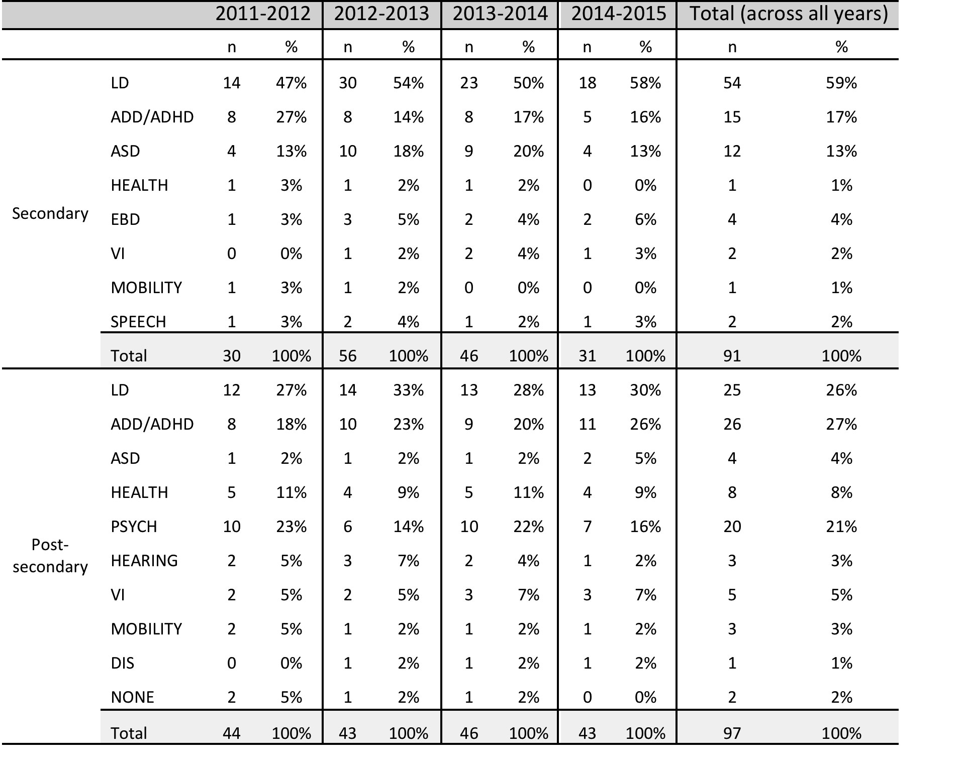
Students by Disability Type

Slide 37
Personal Responsibility
Personal Responsibility | n | Mean | Assessment | Strongly Disagree (1) | Disagree (2) | Neutral (3) | Agree (4) | Strongly Agree (5 )
a. Based on what my mentee has shared, I believe the mentee uses strategies that help him/her become better organized. | 30 | 4.20 | Good | 0% | 3% | 13% | 43% | 40%
b. The mentee and I have discussed how to communicate his/her disability needs to others. | 30 | 3.93 | Attention | 3% | 7% | 13% | 47% | 30%
c. My mentee and I have discussed STEM opportunities. | 29 | 4.17 | Good | 3% | 7% | 3% | 41% | 45%
d. The mentee seems to have more confidence in his/her ability to be successful in STEM courses than when we first began working together. | 30 | 4.07 | Good | 0% | 7% | 13% | 47% | 33%
e. Over the time we have worked together, my mentee has become more interested in STEM classes. | 30 | 3.87 | Attention | 0% | 7% | 33% | 27% | 33%
f. My mentee has talked with me about career and life goals. | 30 | 4.33 | Good | 0% | 7% | 10% | 27% | 57%

Slide 38
Satisfaction
Satisfaction | n | Mean | Assessment | Strongly Disagree (1) | Disagree (2) | Neutral (3) | Agree (4) | Strongly Agree (5)
a. During mentoring, my mentee has been comfortable asking any questions he/she might have had. | 30 | 4.13 | Good | 0% | 10% | 13% | 30% | 47%
b. Through the mentoring experience, my mentee has learned and grown as a STEM student. | 30 | 3.93 | Attention | 0% | 3% | 30% | 37% | 30%
c. I understand the struggles my mentee faces. | 30 | 4.23 | Good | 0% | 3% | 13% | 40% | 43%
d. My mentee and I are a good match for each other. | 30 | 4.07 | Good | 0% | 7% | 23% | 27% | 43%

Slide 39
Communication - Quantity
Communication | n | Mean | Assessment | Not at all Satisfied (1) | Dissatisfied (2) | Neutral (3) | Satisfied (4) | Very Satisfied (5)
a. How satisfied were you with the number of times you communicated with your mentee each week? | 30 | 3.67 | Attention | 0% | 23% | 17% | 30% | 30%
b. How satisfied were you with the length of the mentoring sessions? | 30 | 4.03 | Good | 0% | 13% | 7% | 43% | 37%

Slide 40
Communication - Quality
Communication | n |  | Assessment | Strongly Disagree (1) | Disagree (2) | Neutral (3) | Agree (4) | Strongly Agree (5)
a. The mentee is open and honest in communicating with me. | 30 | 4.33 | Good | 0% | 7% | 10% | 27% | 57%
b. The mentee seeks help from me when needed. | 30 | 4.17 | Good | 0% | 7% | 17% | 30% | 47%
c. The mentee is engaged and receptive to assistance. | 30 | 4.23 | Good | 3% | 7% | 10% | 23% | 57%

Slide 41
Support Seeking
Support Seeking | n | Mean | Assessment | Strongly Disagree (1) | Disagree (2) | Neither (3) | Agree (4) | Strongly Agree (5)
a. The mentoring experience has enabled the mentee to push beyond what is comfortable or easy. | 30 | 3.93 | Attention | 0% | 3% | 33% | 30% | 33%
b. During mentoring, my mentee shares his/her thoughts and feelings. | 30 | 4.10 | Good | 3% | 7% | 7% | 43% | 40%
c. I have been able to help my mentee get the information and resources he/she needs. | 30 | 4.33 | Good | 0% | 0% | 10% | 47% | 43%
d. The mentoring experience has helped my mentee solve problems. | 30 | 4.07 | Good | 0% | 3% | 23% | 37% | 37%
e. The mentoring experience has helped my mentee make life decisions. | 30 | 3.93 | Attention | 0% | 3% | 30% | 37% | 30%

