Slide 1

Allison Arnold, Kris Biesinger, Lisa Townsley
University of Georgia
Nathan Moon
Georgia Institute of Technology

Slide 2

USG Initiatives
N
L
M
New Learning Models

Slide 3
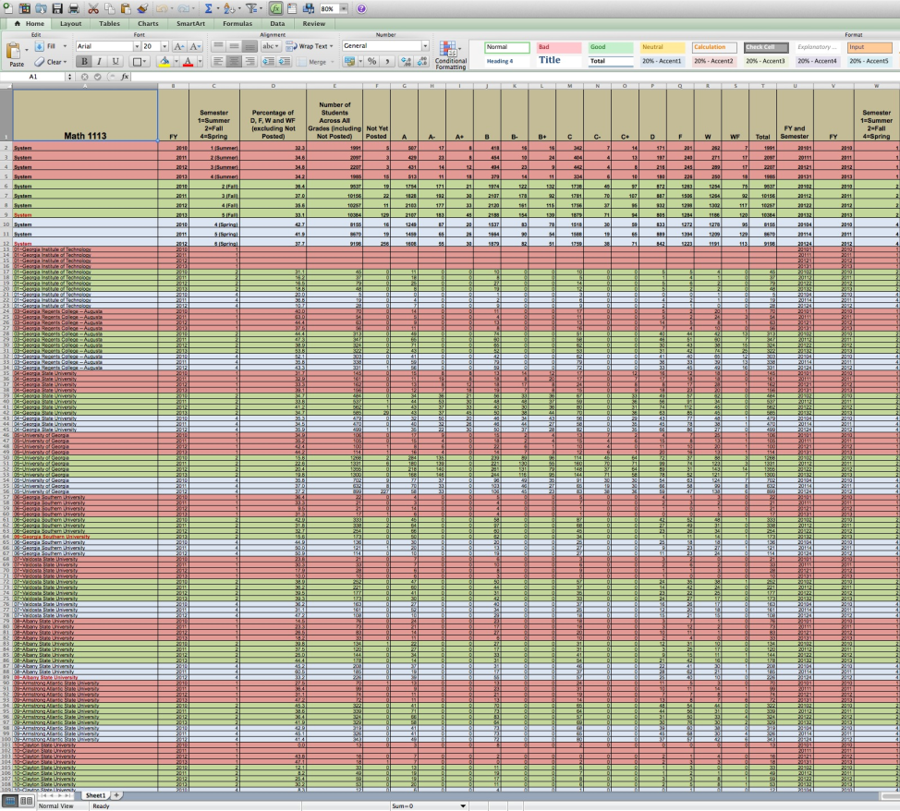

A Critical Need – MATH 1113 Precalculus
37.7%
Do Not Succeed
USG 2013 System average percentage of D, F, W and WF (excluding Not Posted)

Slide 4
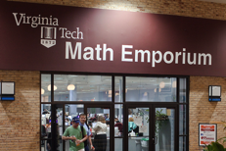
A Promising Approach: The Emporium Model

Slide 5

Emporium Success Factors
Require active learning. Emphasis on doing as opposed to listening to how to do math.
Ensure sufficient time on task. Math activity is required (lab hours/exercises).
Build in ongoing assessment and prompt (automated) feedback.
Monitor student progress and intervene when necessary.
Provide one-on-one, on-demand assistance from highly trained personnel.

Slide 6



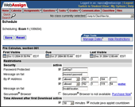

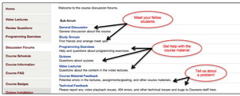



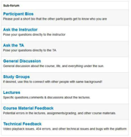


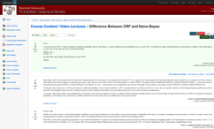


USG Virtual Emporium
GUIDED
PRACTICE
CONTEXT
TUTORIALS
& TUTORS
CONTENT
“The virtual classroom is a space, a territory, where learning can happen.”
PROCTORED
TESTING

Slide 7
Online Precalculus Course Project
Institutional Partners
Georgia State University
Georgia Perimeter College
Middle Georgia State College Design & Delivery
University of Georgia
Valdosta State University
Georgia Tech
Coursera Development
Accessibility Guidance
Project Evaluation

Slide 8
Timeline & Goals
Timeline:
Develop Course in Fall 2013
Offer Pilot Course in Spring 2014
Goals:
Up to 300 Students from 5 Institutions
Evaluate Impact of the Model
Continue to Improve the Model
Scale to More Institutions
Modify Teaching Support Model

Slide 9
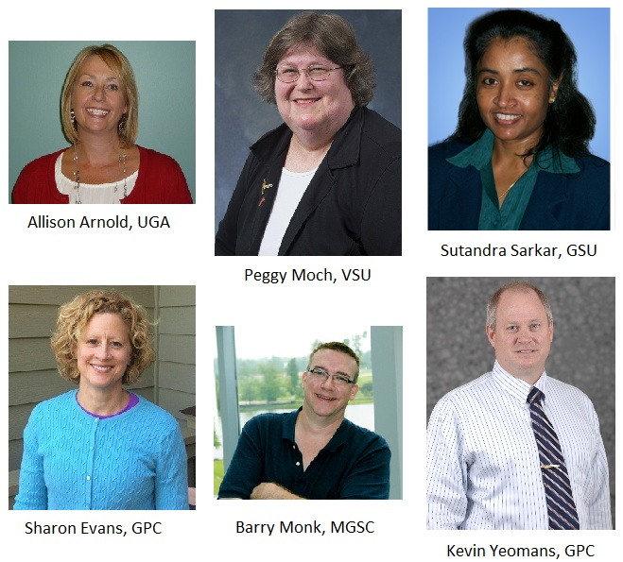
Who Are the Instructors?

Slide 10




What Are the Platforms?

Slide 11
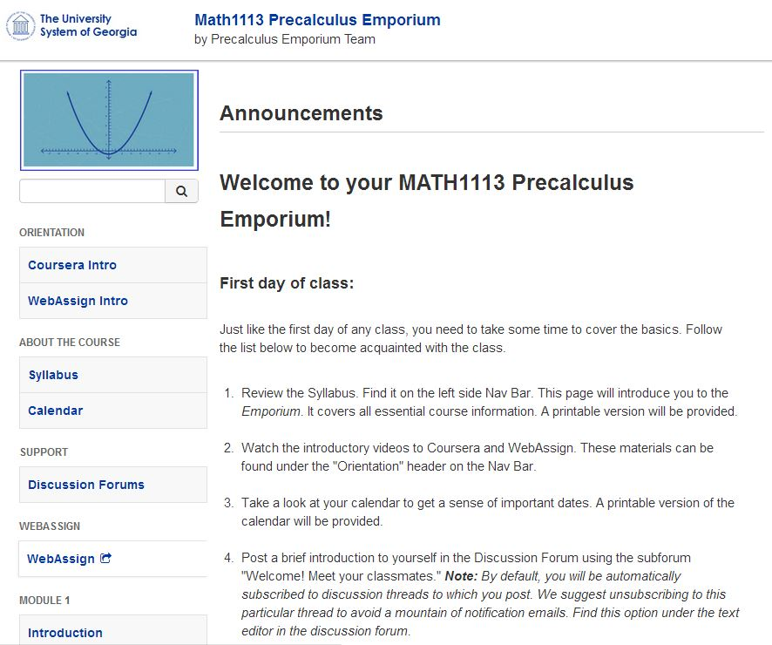
Student View – Course Home in Coursera

Slide 12
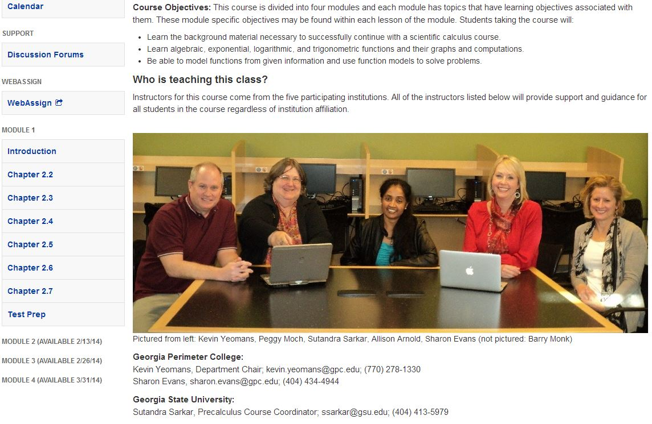
Student View - Syllabus

Slide 13
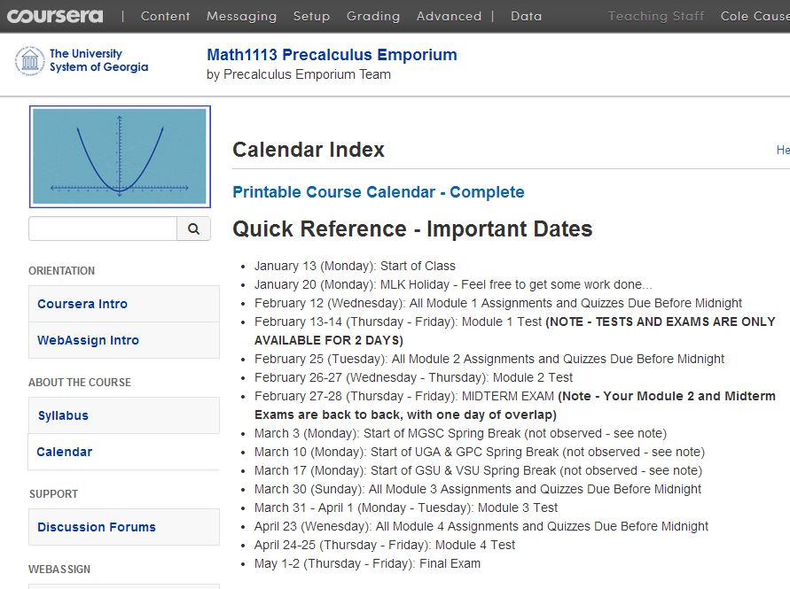
Student View - Calendar

Slide 14
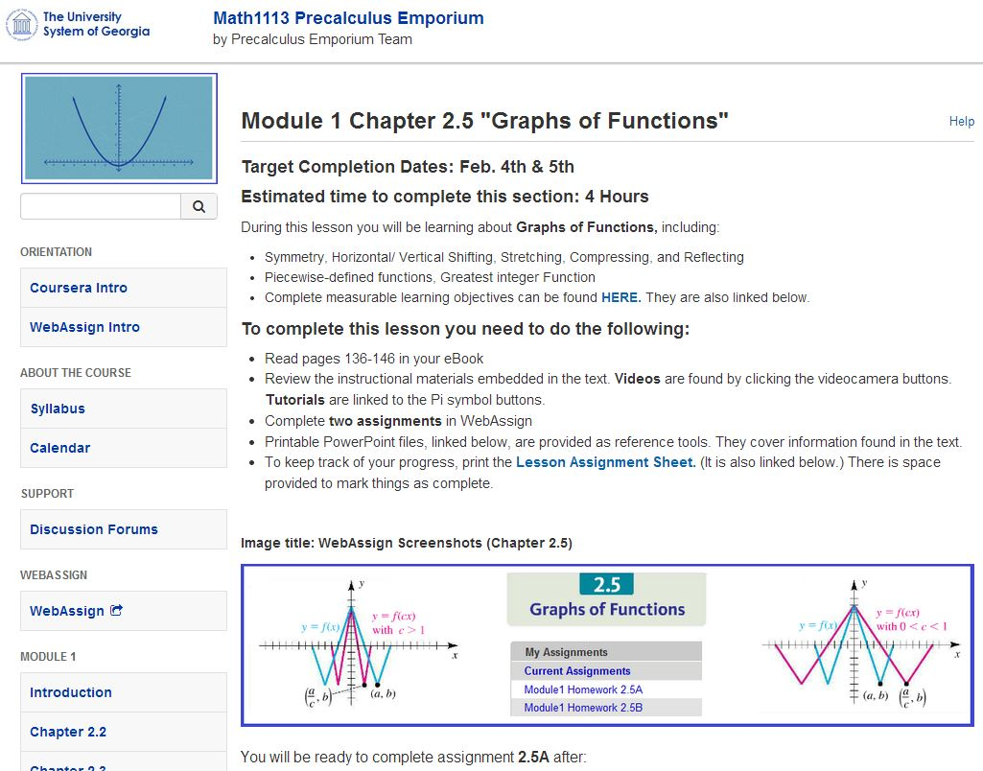
Student View – Lesson Overview

Slide 15
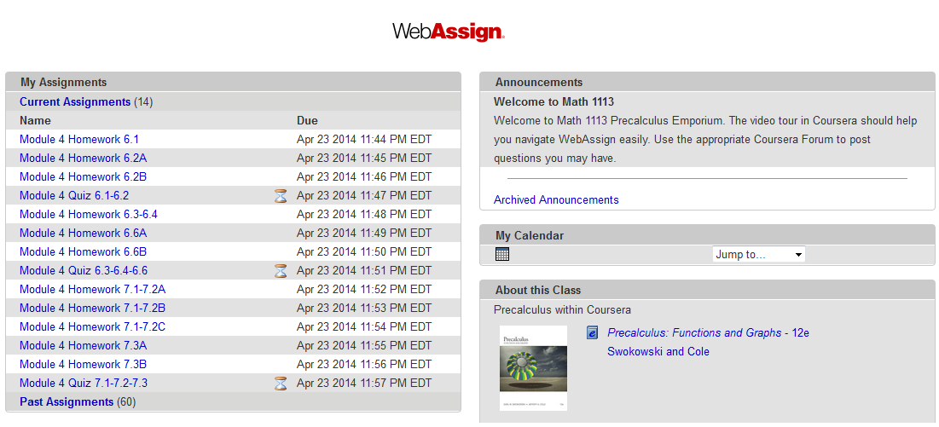
Student View – WebAssign

Slide 16
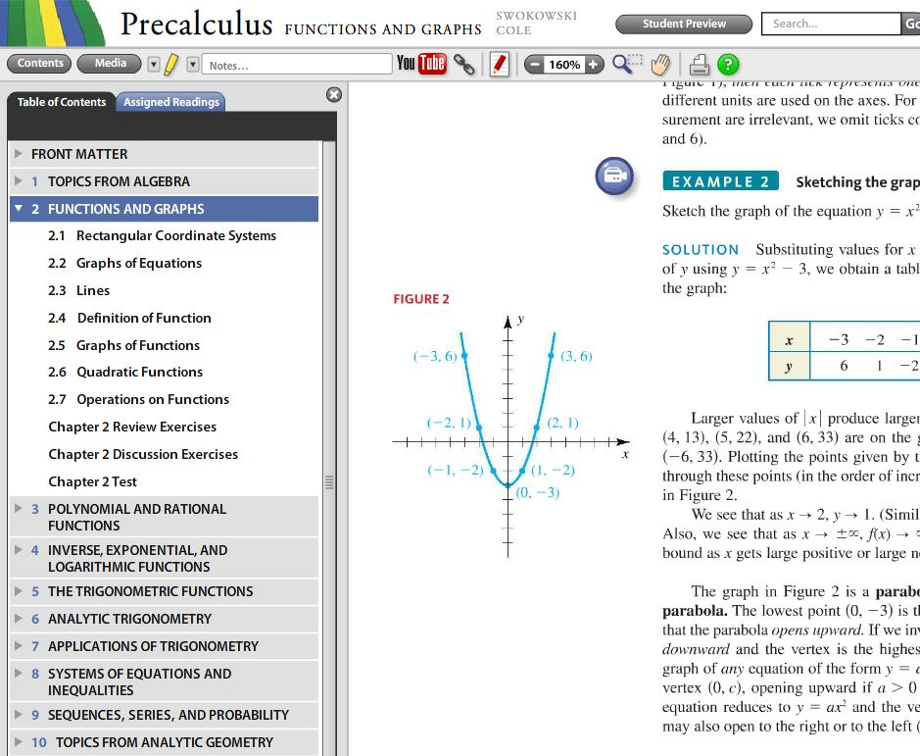
Student View – eBook

Slide 17
Student View – Sample Problem
Textbook provided
question with help
icons

Slide 18

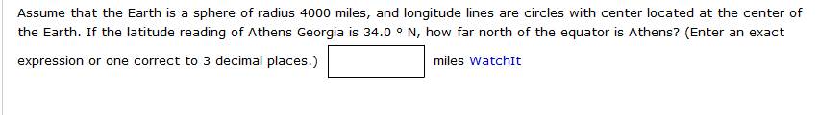
Student View – Sample Problem
Homegrown question with calcPad
Many now have help button, too.

Slide 19
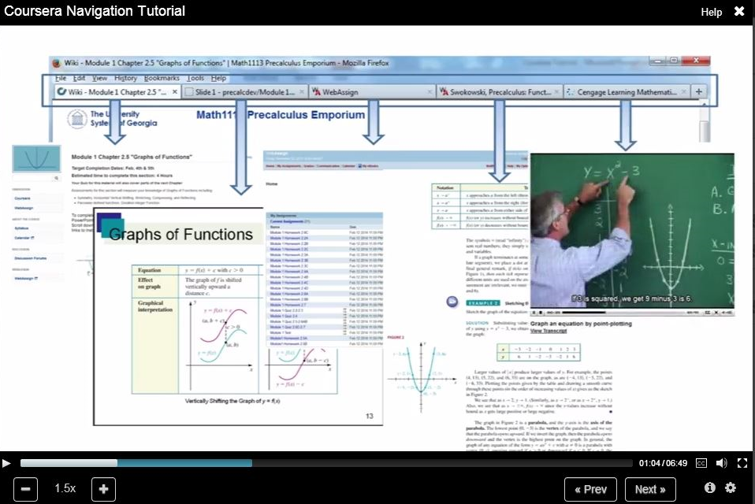
A Wealth of Resources

Slide 20
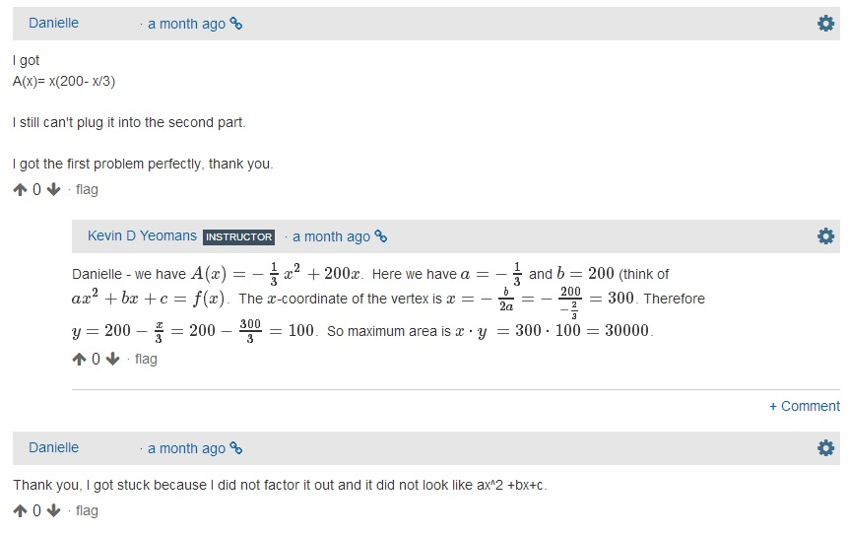
Support – Discussion Forums in Coursera

Slide 21
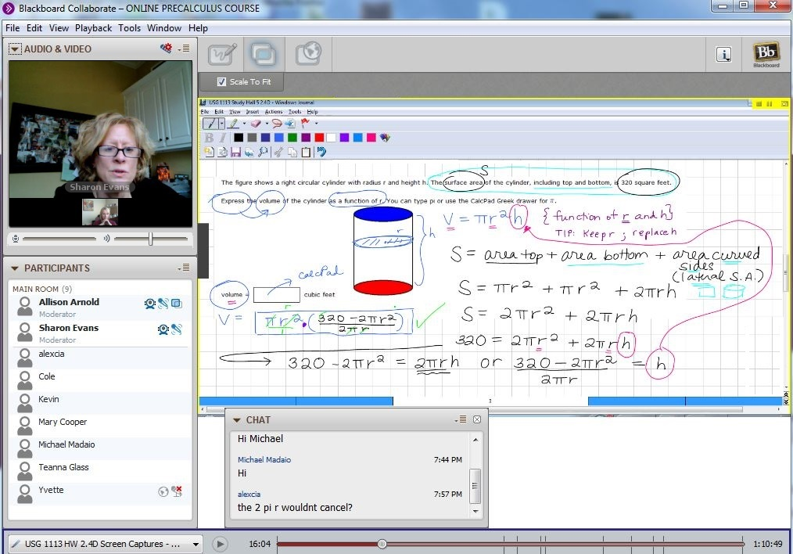
Support – “Study Halls” via Collaborate

Slide 22
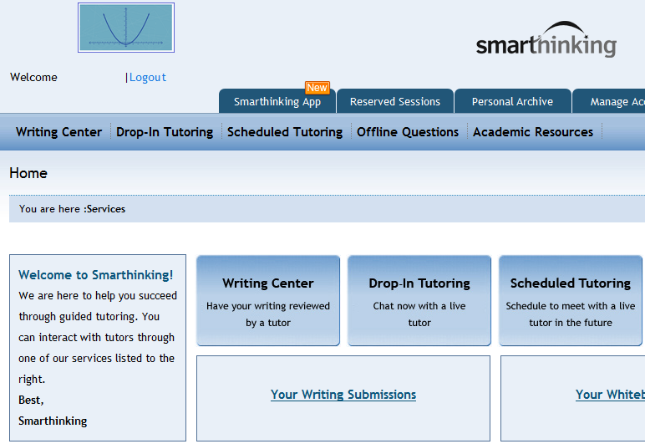
Support – 24 hr tutoring via Smarthinking

Slide 23
Student Perceptions/Feedback
Helpfulness, Timeliness of Instructors
Discussion Forums and Study Halls as Positive to Learning Outcomes
Technology of Less Concern than Instructional Materials
Interest in More Video Content and Direct Instruction

Slide 24
Next Steps
Review Evaluative Data
Refine Course (Platforms and Materials)
Expand Number of Participating Institutions and Continue to Pilot in Fall 2014
Address Faculty Load & Responsibilities
Develop Long-Term Business Model

Slide 25
Questions?
For More Information, Contact:
Dr. Kris Biesinger, Project Manager
krisb@uga.edu
Dr. Nathan Moon, Evaluator
nathan.moon@cacp.gatech.edu
MATH 1113 Online Project Acknowledges the Support of the Office of College Access and Success, University System of Georgia

